Slide 1
Superstore USA Analytics Report
DASHBOARD SUMMARY

Slide 2
EXECUTIVE SUMMARY
Total Sales: ₹0.73M
Profit Margin: 14.94%
Return Rate: 5.91%
The superstore has achieved a solid sales performance with a healthy profit margin of nearly 15%, indicating efficient cost and pricing management.
However, the return rate of 5.91% suggests a potential area for improvement, possibly linked to product quality, customer satisfaction, or order fulfillment accuracy.

Slide 3
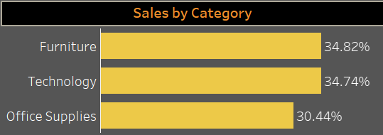
SALES BY CATEGORY
Furniture (34.82%) leads slightly over Technology (34.74%)
Office Supplies lowest (30.44%) among the three

Slide 4
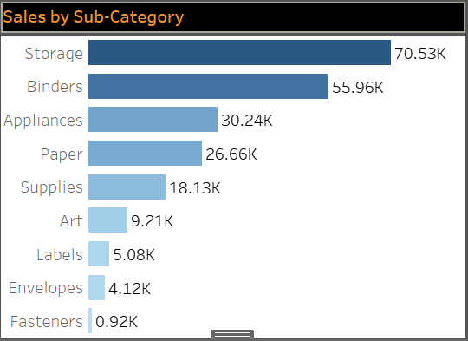
SALES BY SUB-CATEGORY
Top: Storage (70.53K), Binders (55.96K)
Bottom: Fasteners (0.92K), Envelopes

Slide 5
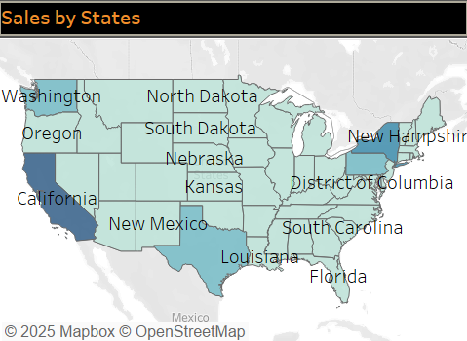
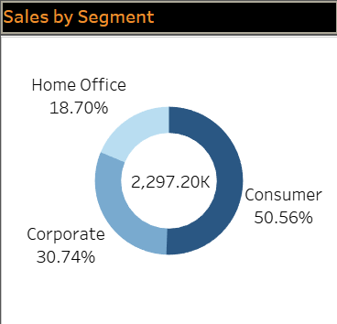
REGIONAL & SEGEMENT ANALYSIS
Region Filter : East, West, North, South
California is leading the state.
Segment Wise : Consumer dominates over Home Office & Corporate

Slide 6
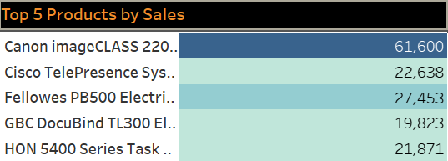
TOP PRODUCT SALES
Key Product: “Canon image CLASS 220…" with 61.6K sales
Insight: Potential for promoting this product more in marketing campaigns

Slide 7
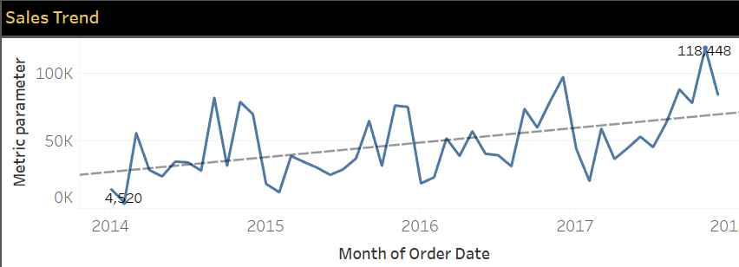
SALES TREND OVER TIME
Line Graph: Monthly order data trend
Insights:
Sales peaks around late 2017 (~14.86K).
Consistent growth trend over years.

Slide 8
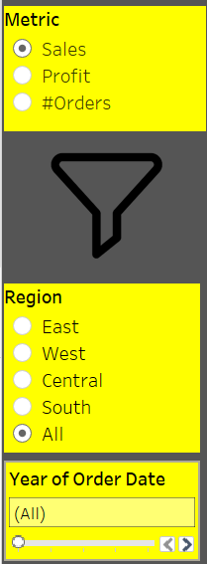
INTERACTIVE FILTERS & METRICS
Filters Covered:
Metric Selector (Sales, Profit, Orders).
Region, Year of Order Date.
Use Case:
Explain how the dashboard allows stakeholder-specific drilldowns.

Slide 9
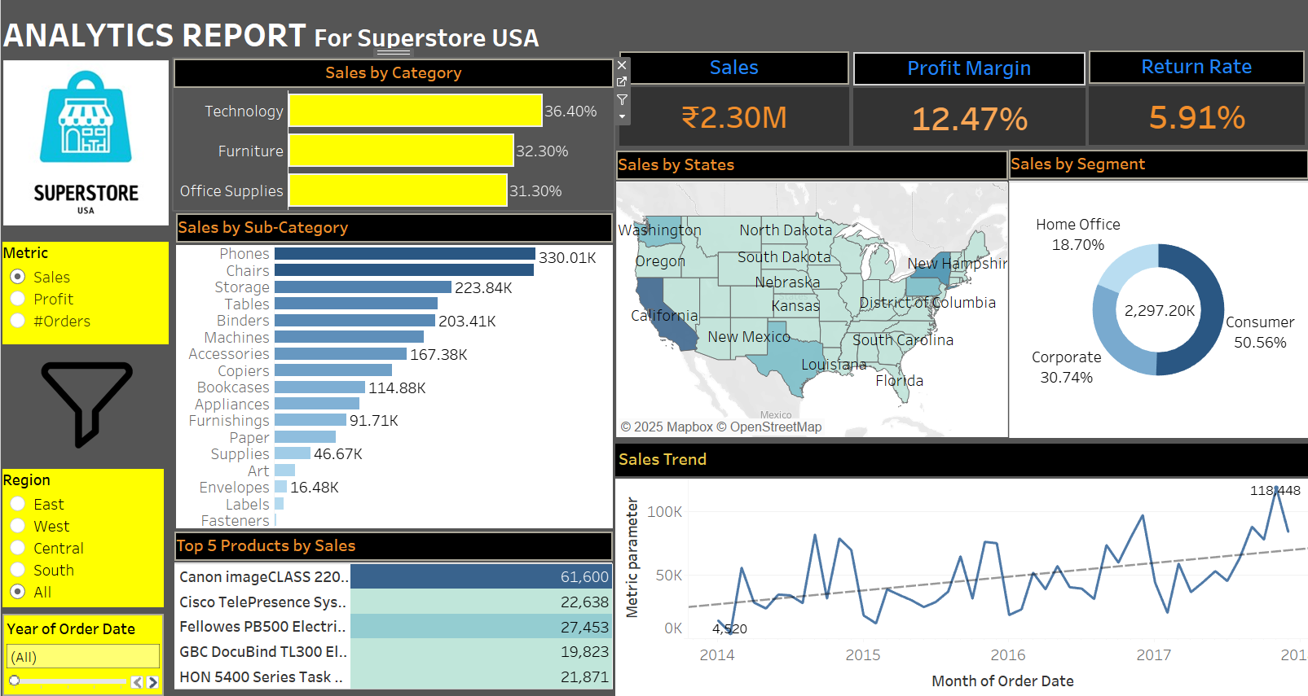

Slide 10
CONCLUSION
The analysis highlights a strong overall performance in terms of sales and profitability.
Categories like Furniture and Technology are nearly equal in contribution, while California leads among states.
Consumer segment dominates sales, followed by Corporate.
However, a notable return rate of 5.91% calls for attention.
Sales trends show a positive upward movement, suggesting a healthy market response and seasonal opportunities.

Slide 11
RECOMMENDATIONS
Reduce Return Rate:
Analyze reasons for returns and improve packaging, product quality, and fulfillment accuracy to enhance customer satisfaction.
Boost Low-Performing Categories: Launch targeted promotions and product bundles for Office Supplies and underperforming sub-categories to increase visibility and sales.
Promote Best-Selling Products: Highlight top products like the Fellowes Punch Machine in marketing campaigns to maximize their sales potential.

Slide 12
THANK YOU !!!

